Slide 1
The Value of Electric Hybrid Water Heaters (EHWH)
Helping Consumers Make the Best Water Heating Decisions
Links & Resources
Notes:
P1001
Point of Slide: Title Slide – The Value of Electric Hybrid Water Heaters (EHWH), Helping Consumer Make the Best Water Heating Decisions

Slide 2
Table of Contents
Page 1 – Title Page
Page 2 – Table of Contents
Page 3 – Hot Water Solutions Resource Links & Contact Information
Page 4 – Manufacturer Resource Links & Contact Information
Pages 5-6 – Qualified Products List
Page 7 – Energy Usage
Page 8 – Space Heat Interaction
Page 9 – How Much Time Do EHWHs Operate at Different Temperatures?
Page 10 – Product Compatibility: Sizing Considerations
Page 11 – Installation Considerations: Open Basement
Page 12 – Installation Considerations: Garages
Pages 13-15 – Noise
Page 16 – Noise Mitigation
Pages 17-18 – Manufactured Home Installations
Page 19 – Tank Selection Criteria
Page 20 – Cold Climate Zones
Page 21 – Cold Climate Considerations
Pages 22-23 – Exhaust-Only Ducting Energy Savings Comparison
Page 24 – Differences Between Standard Electrics and EHWHs
Page 25 – EHWH Benefits
Page 26 – EHWH Benefits vs Standard Tanks
Page 27 – Thank You
Notes:
P0125
Point of Slide: Provides information and resources for available utility rebate programs

Slide 3

Hot Water Solutions
Resource Links & Contact Information
    Hot Water Solutions Consumer Resource Center
    http://hotwatersolutionsnw.org/
    Hot Water Solutions Partner Resource Center
    https://hotwatersolutionsnw.org/partners
    Utility EHWH Rebate Programs
    hotwatersolutionsnw.org/participating-utilities
    Hot Water Solutions Contact Information
    Email: info@hotwatersolutionsnw.org
    Phone: (888) 444-8962
Notes:
P0130
Point of slide: Provide follow up materials and resources

Slide 4
Manufacturer Resource Links & Contact Information
    A. O. Smith
    https://www.hotwater.com/
    Support – (877) 552-0010
    Training - https://university.hotwater.com/contact/
    Sales Representatives - https://www.hotwater.com/where-to-buy/trade-professionals/
    Distributors -https://www.hotwater.com/where-to-buy/search/
    User Manuals - https://www.hotwater.com/resources/product-literature/instruction-manuals/residential-electric/
    Spec Sheets - https://www.hotwater.com/resources/product-literature/spec-sheets/residential-electric-(uef)/
    Bradford White
    https://www.bradfordwhite.com/forthepro
    Support – (800) 523-2931
    Training – https://www.bradfordwhite.com/training/
    Sales Representatives – https://www.bradfordwhite.com/rep-locator/
    Distributors - https://www.bradfordwhite.com/resources-for-professionals-wholesaler/
    User Manuals & Spec Sheets - https://www.bradfordwhite.com/documentation/usa/residential/tank-type-gas
    Rheem
    https://my.rheem.com/
    Support – (800) 621-5622
    Training – https://www.rheemacademy.com/
    Sales Representatives – https://www.rheem.com/find-a-pro/
    Distributors – https://www.rheem.com/find-a-pro/
    User Manuals & Spec Sheets - https://www.rheem.com/products/residential/water-heating/heat-pump-water-heaters/
Notes:
P0121
Point of slide: Provide contact information and resources of all three EHWH manufacturers

Slide 5
Qualified Products List
Table 1. Integrated HPWH Product Tier Overview
Tier | Minimum Cool Climate Efficiency (CCE) | Minimum Features | Sound Levels
Tier 1.0 | 2.0 | ENERGY STAR compliance Freeze protection | dBa < 65
Tier 2.0 | 2.3 | Tier 1 plus: Minimal use of resistance heating elements (see Section 5.1) Compressor shut-down/notification 10 year warranty Condensate management | dBa < 60
Tier 3.0 | 2.6 | Tier 2 plus: Simultaneous intake and exhaust ducting capabilities Air filter management Override and default mode behavior as per Section 6.1 | dBa < 55
Tier 4.0 | 3.0 | Tier 3 plus: Physical design or default controls that limit resistance element heating to less than upper 50% of tank | dBa < 50
Tier 5.0 | 3.5 | Tier 4 plus: No resistance element usage in default | dBa < 50
https://neea.org/our-work/advanced-water-heating-specification
Notes:
P0006
Point of Slide: Provide guidance for contractors to understand product tiers, and the differences between them

Slide 6
Qualified Products List (cont.)
Table 2. Split-System HPWH Product Tier Overview
Tier | Minimum SCOP* | Minimum Features | Sound Levels
Tier 1.0 | 2.1 | ENERGY STAR compliance Freeze protection | dBa < 65
Tier 2.0 | 2.4 | Tier 1 plus: Minimal use of resistance heating elements (see Section 5.1) Compressor shut-down/notification 10 year warranty Condensate management | dBa < 60
Tier 3.0 | 2.7 | Tier 2 plus: Override and default mode behavior as per section 6.1 | dBa < 50
Tier 4.0 | 3.1 | Tier 3 plus: Physical design or default controls that limit resistance element heating to less than upper 50% of tank | dBa < 50
Tier 5.0 | 3.6 | Tier 4 plus: No resistance element usage in default mode unless outside ambient air temperature is below -5°F | dBa < 50
* SCOP (seasonal coefficient of performance) is a different variable from CCE. SCOP applies to split systems for which the heat pump is subject to outdoor air conditions (see Appendix B.4). The reference climate for the SCOP comprises a combination of the climate of five Pacific Northwestern cities.
https://neea.org/our-work/advanced-water-heating-specification
Notes:
P0007
Point of Slide: Provide guidance for contractors to understand split system tiers, and the differences between them

Slide 7
Energy Usage
    Water heating is the #2 top energy user in the home
Source: EnergyStar.gov
Notes:
P1039
Point of slide: Speak to the costs of water heating in general and demonstrates cost savings of EHWHs

Slide 8
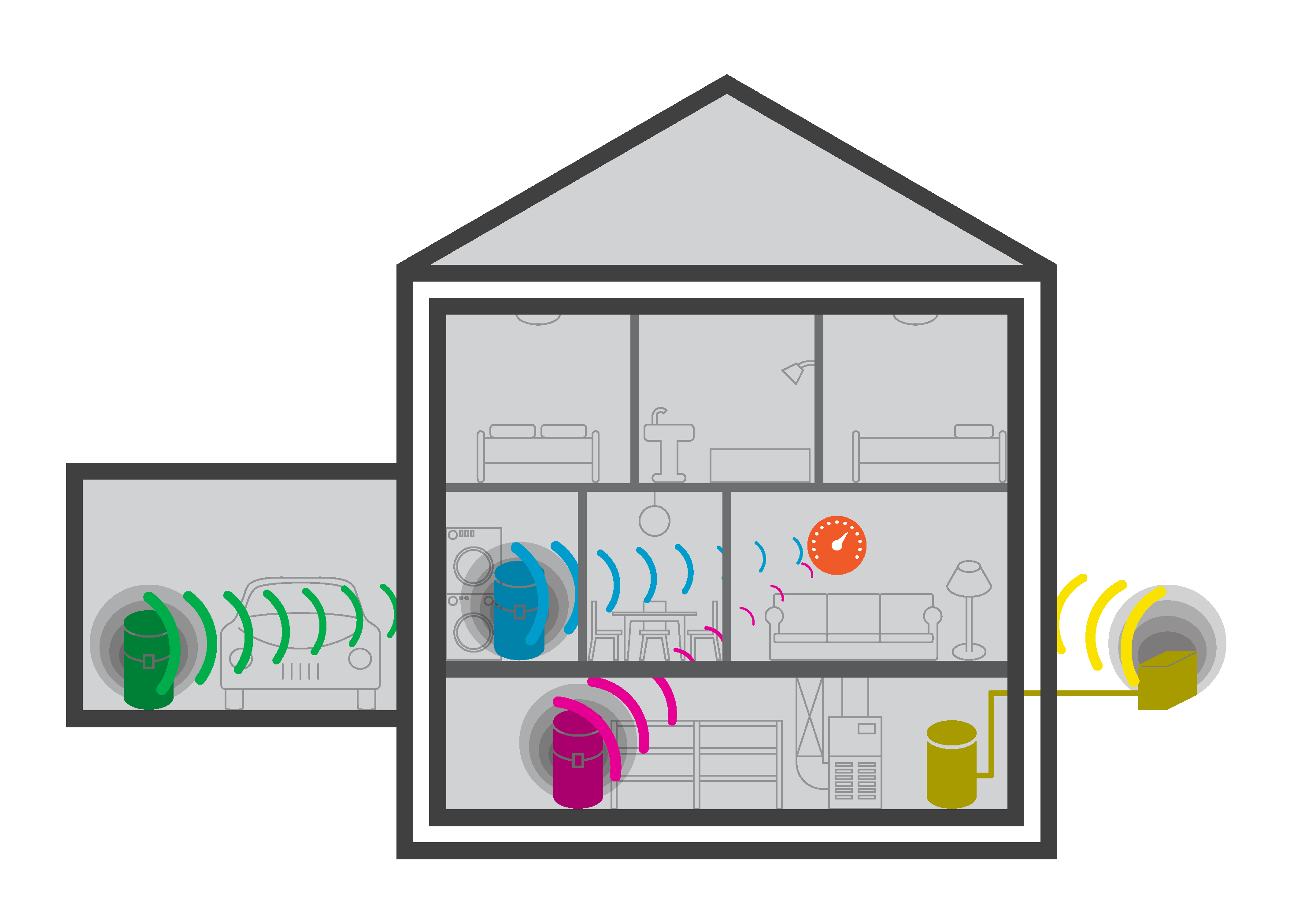
Space Heat Interaction
Space Heat Interaction [1]
Fully-Conditioned Space
Mainfloor Utility Closet, Laundry Room
Cooling effect is largely limited to rooms where HPWH installed, and typically sufficiently isolated from thermostat to have minimal effect on space heating system.
Effect further limited by HPWH’s ability to capture excess heat (heating shoulder season, solar gains, latent heat).
Split-System HPWH
Heat pumps installed outside a house have no measurable impact on space conditioning.
Non-Conditioned Space
Garage, Attic, Exterior Storage Closet
No noticeable impact on
space-heating system. Heat is replaced from outside.
Semi-Conditioned Space
Basement
In spaces within insulated building envelope but not actively heated, feedback to space heating system is limited even further than in fully conditioned spaces.
[1] Ben Larson, Larson Energy Research
Notes:
P1011
Point of Slide: Highlight space heat interaction study and results

Slide 9
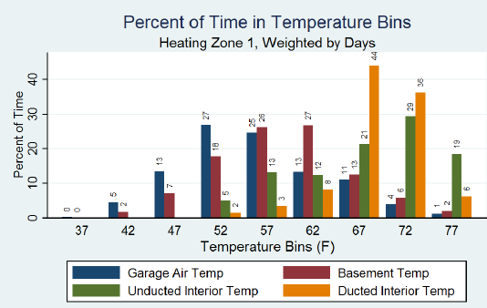
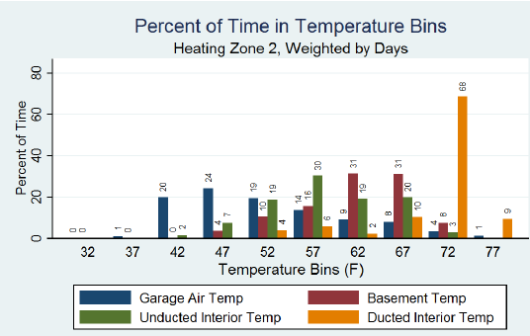
How Much Time Do EHWHs Operate at Different Temperatures?
Northwest garages typically stay above operating range temperatures, even in zones 1 & 2, making them ideal installation locations.
Heating Zones 1 & 2 cover the vast majority of the populated PNW.
If you are worried EHWHs working in colder spaces, put the units in Hybrid Mode.
Notes:
P1015
Point of Slide: Northwest garages typically stay above operating range temperatures, even in zones 1& 2, making them ideal installation locations

Slide 10
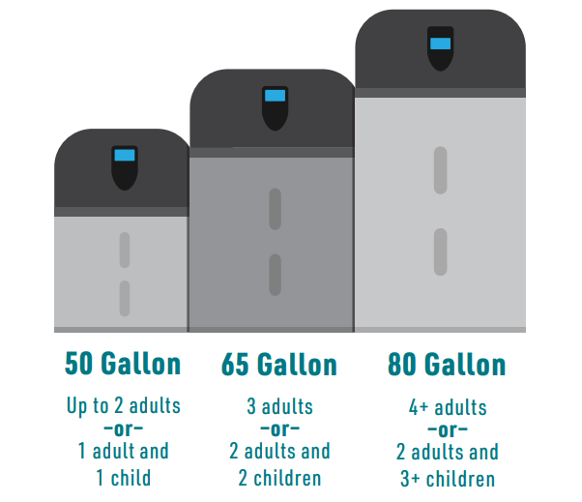
Product Compatibility: Sizing Considerations
Choosing the right tank for a household
Size the tank appropriately to meet the household’s needs according to:
Family size
Hot water demand requirements
Installation location
Make sure the water heater can handle the household’s hot water usage by considering the number of bedrooms and bathrooms in the house.
If the location allows for a larger tank, it is best practice to size up one tank size.
Plumbing codes specify the size of the tank based on the number of bedrooms and bathrooms in a household and categorize the tank by the first-hour rating.
Notes:
P1047
Point of Slide: Provide recommendations for choosing the right size tank for a household - recommendation to size up a size

Slide 11
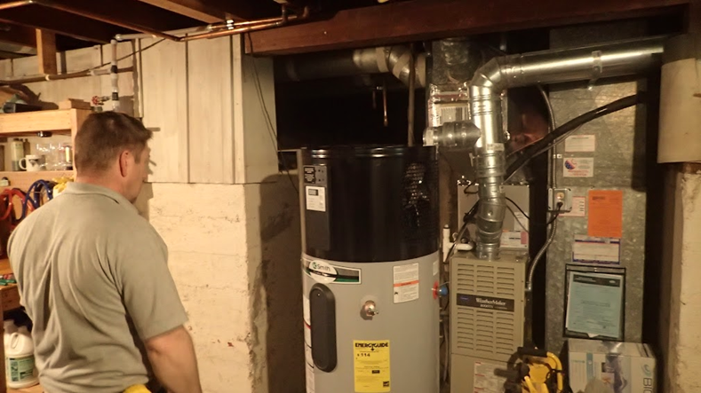
Installation Considerations: Open Basement
Generally, basements are above minimum volume requirements
Direct exhaust air away from walls in proximity of unit
Direct exhaust away from routine activities such as washing machines
Drain condensate to floor or other drain
If unit is located near an existing air handler that utilizes a condensate pump to dispose of condensate, the existing pump can additionally be utilized for the condensate produced by EHWHs
Notes:
P1055
Purpose:

Slide 12
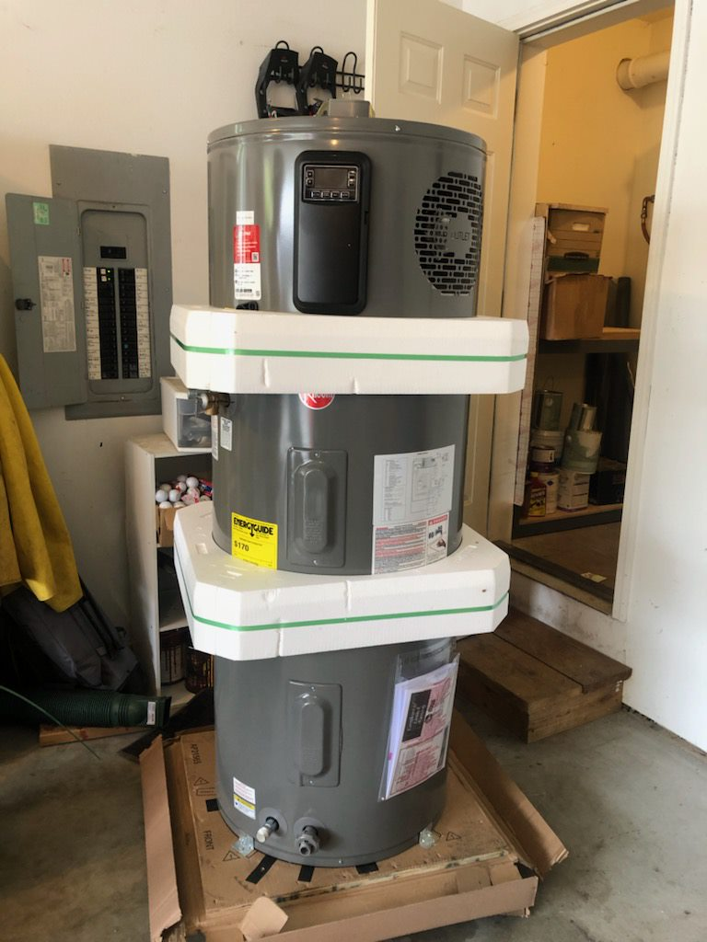
Installation Considerations: Garages
In the Northwest, garages are generally well insulated and stay above 35 degrees, except in extreme conditions
Top or side plumbing not an installation consideration, as space is generally not a limiting factor
Often require no ducting or ducting considerations
Drain condensate to the nearest drain location or directly outside
If installing on interior facing wall, sound absorbing material such iso pads and foam pipe insulation can be installed to minimize the mechanical transfer to the wall
  Install sound absorbing materials before cinching down seismic strapping
Bring and install insulation pad
Notes:
P1057
Purpose:

Slide 13
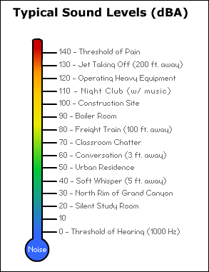
Noise
Average EHWH
Heat pump water heaters range in decibel ratings of 45 to 52 decibels.
  About the same level as a modern dishwasher.
The decibel scale is logarithmic.
  A decibel increase of 10 represents a doubling of perceived loudness.
Notes:
P1059
Point of Slide: Explain noise scale and provides real-world comparisons for relativity

Slide 14
Noise (cont.)
  Noise level
  Sound decibels measured on an 80-gallon EHWH [1]:
53 dBA — one foot straight out from the exhaust port
48 dBA — one foot to the side of the exhaust port
46 dBA — five feet away, at the mechanical room door
37 dBA — four feet to the side of the mechanical room door
For reference, here are other noise levels on this scale:
60 dBA — normal conversation
50 dBA — rainfall
40 dBA — refrigerator hum
30 dBA — soft whisper
Five feet away from the tank measured at around the noise level of a refrigerator hum.
[1] Allison Bailes, 2021, Energy Vanguard, “Living With a Heat Pump Water Heater”, Living With a Heat Pump Water Heater - Energy Vanguard
Notes:
P1060
Point of Slide: Provide real world EHWH sound results from a measured installation study

Slide 15
Noise (cont.): Consumer Satisfaction
Noise level
70% of homeowners indicated the noise from their EHWH is hardly noticeable [1]
[1] Dan Cautley, Kevin Gries, Dianna Cacko, and Justin Margolies, 2021, “Installed Performance of Heat Pump Water Heaters in a Cold Climate”
Notes:
P1064
Point of Slide: Provide real world example of consumer feedback on EHWH noise

Slide 16
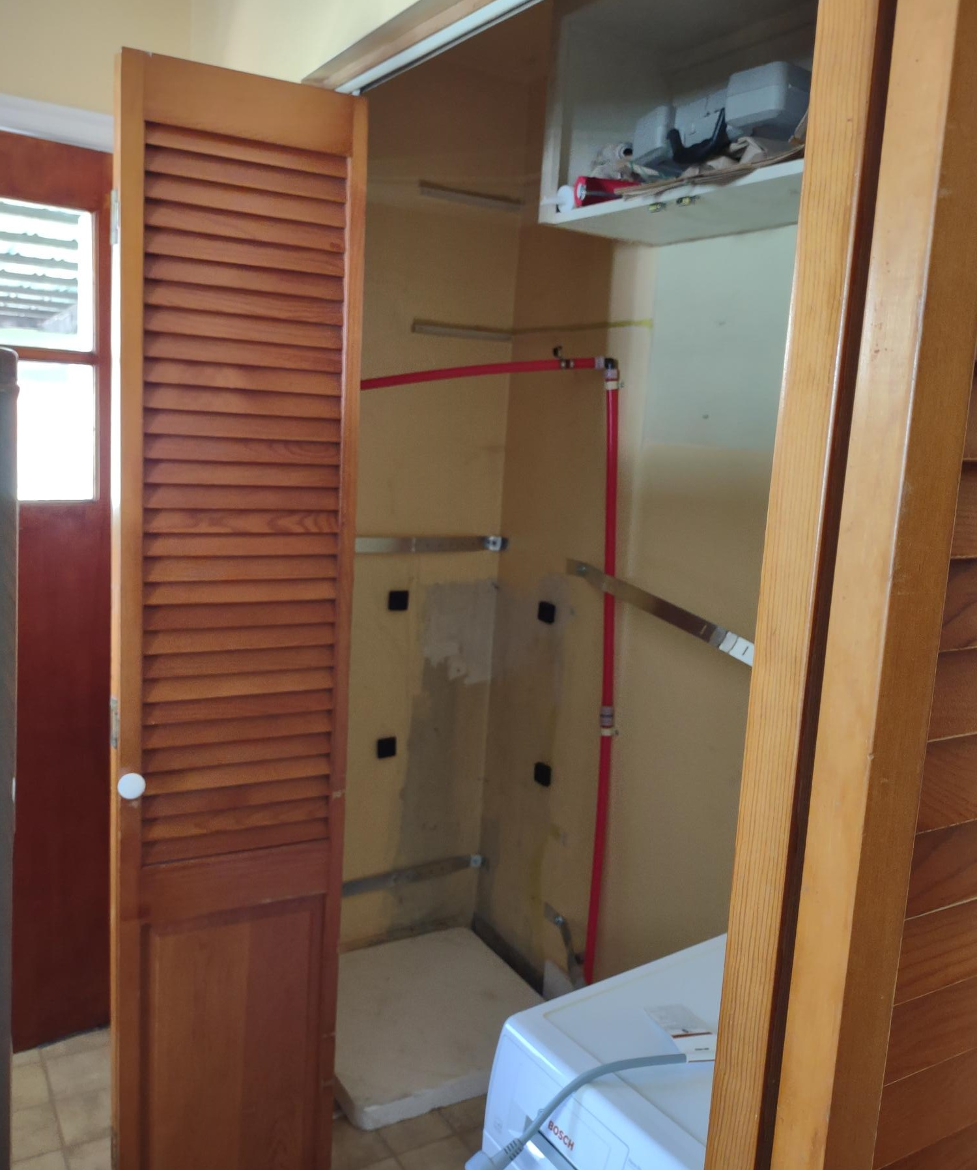
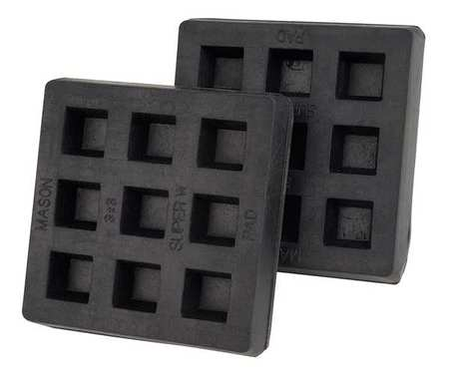
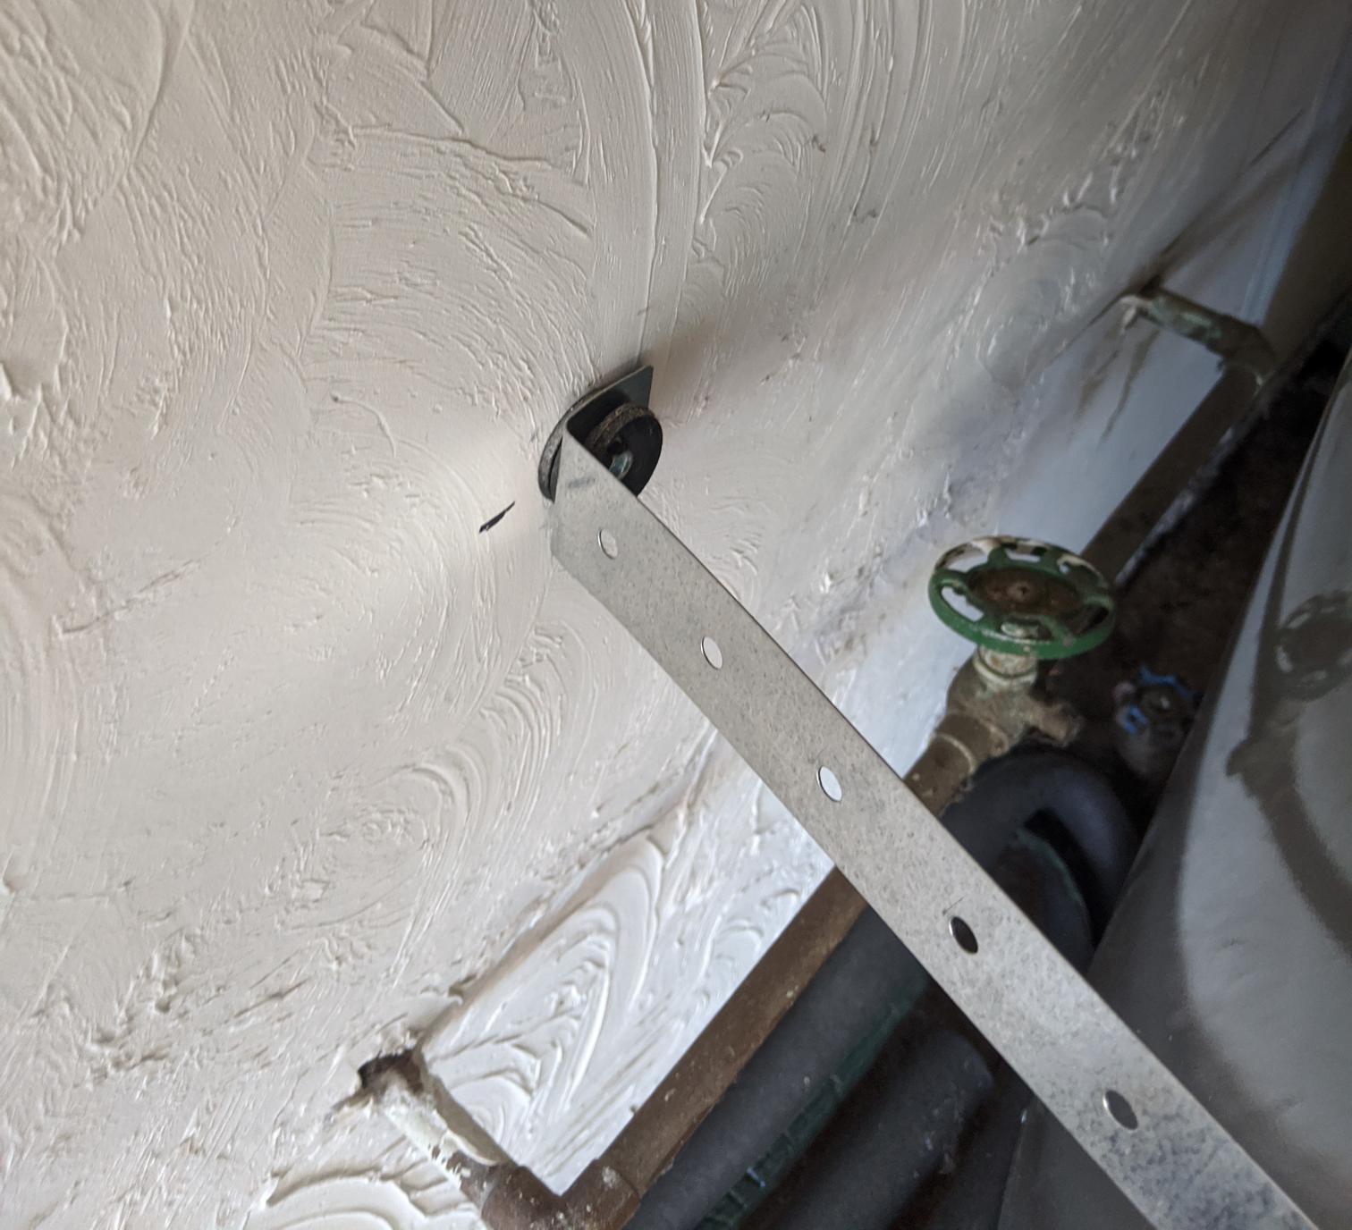
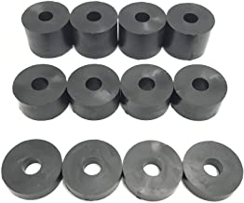
Noise Mitigation
  Low-Noise Tips for Installation:
Choose the right location for installation
Don’t put in high occupancy areas where the noise will become bothersome to the homeowner
Seismic strapping considerations:
If installing in an area that requires seismic strapping, the vibration from the tank will travel through the wall and echo
Example: Isolation pads are an option to further reduce noise and vibrations between EHWH and two walls.
Neoprene washers or stand-offs are used to anchor seismic straps.
Washer used on both sides of the strap.
Notes:
P1063
Point of Slide: Provide recommendations for low-noise installation, and seismic strapping considerations.

Slide 17
Manufactured Home Installations
Typical Installation Sequence
Screening
Tank Selection
On-site planning
Drain and remove existing tank/ closet alterations
  Breaker size
  Closet location/size
  Approval to alter closet
  Floor damage
  Breaker size
  Size of household
  Back or side vented
  Piping runs
  Detailed ducting or louvering planning
  Drain/remove tank
  Closet alteration
Price is higher than site-built garage install:
  $300 to $700 more excluding any electrical
  Upgrading electrical can add $350 to $500
High levels of consumer satisfaction
Reported increased tank temperature
Notes:
P1075
Point of Slide: Introduce typical installation sequence for manufacturer homes

Slide 18
Manufactured Home Installations (cont.)
Typical Installation Sequence (Continued)
Breaker size and exhaust orientation can determine tank selection
Ducting and louvering
Placement of EHWH
Plumbing
Commissioning
  Cut in holes for ducts/louvers
  Install duct adaptors if needed
  Drain pan installation
  Lift tank into place
  Orientation of tank to optimum position
  Connect ducting to tank
  Connect hot cold pipes
  Fill tank
  Connect PT valve, drain pan and condensate lines
  Wire and energize tank
  Check for leaks
  Observe start up sequence
Price is higher than site-built garage install:
  $300 to $700 more excluding any electrical
  Upgrading electrical can add $350 to $500
High levels of consumer satisfaction
Reported increased tank temperature
Notes:
P1076
Point of Slide: Introduce typical installation sequence for manufacturer homes

Slide 19
Tank Selection Criteria
Attribute | Rheem 30 amp | Rheem 15 amp | Bradford White | A. O. Smith Voltex | A. O. Smith Voltex AL
Breaker Requirement | 30 amp | 15 amp | 25 amp | 30 amp | 30 amp
Exhaust | Right Side | Right Side | Back Side | Right Side | Top
Hot/Cold Plumbing Connections | Side | Side | Top | Side | Top or Side
PT/Condensate Connections | Front | Front | Side | Side | Front
Compressor Cutout Temperature | 37⁰F | 37⁰F | 35⁰F | 45⁰F | 37⁰F
Best Suited For: | 30 amp breaker, side exhaust air | 15 amp breaker/side exhaust air | 25 amp breaker/rear air discharge | 30 amp breaker, side exhaust air | 30 amp breaker, good fit for small closets due to top exhaust and intake
Other Notes | Depending on model, features such as app and water leak detection may be a plus | Depending on model, features such as app and water leak detection may be a plus | Top plumed hot and cold-water connections may not be a benefit when hot/cold piping is from the floor | High compressor shut temp will impact saving in double ducting installs | Equipped with water leak detection technology and smart app connectivity
Breaker size and exhaust orientation can determine tank selection
Price is higher than site-built garage install:
  $300 to $700 more excluding any electrical
  Upgrading electrical can add $350 to $500
High levels of consumer satisfaction
Reported increased tank temperature
Notes:
P1081
Point of Slide: Support contractor decision to pick the right tank for the job

Slide 20
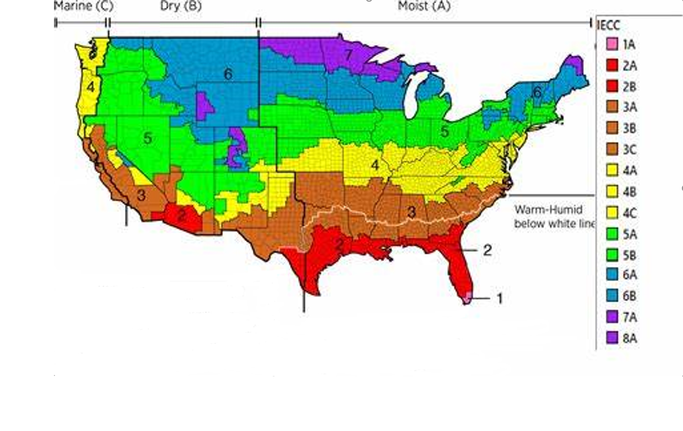
Cold Climates Zones
If a consumer lives in a “cold climate”, or climate zones 6 and 7 (as indicated by blue and purple on the map), basements are excellent locations for tank installations. Ducting using outside air would result in long periods of operation as a standard tank and decrease energy savings.
All of Alaska is in Zone 7 except for the following boroughs in Zone 8:
Bethel, Northwest Arctic, Dellingham, Southeast Fairbanks, Fairbanks N. Star, Wade Hampton, Nome,
Yukon-Koyukuk, North Slope
Zone 1 includes Hawaii, Guam, Puerto Rico, and the Virgin Islands
IECC Climate Zones (homerenergy.com)
Notes:
P1085
Point of Slide: Introduce and define cold climate territories for reference in following slides

Slide 21

Cold Climate Considerations
    Performance
    Condensate
Basement locations are ideal
Avoid ducting that connects inside of house to outside (intake or exhaust)
EHWH switches to electrical resistance mode to prevent condensate at freezing temperatures
Internal drainage if possible
If not possible, limit any outside exposure to prevent freezing of pipes
Notes:
P1086
Point of Slide: Introduce important aspects for EHWH installations in cold climates

Slide 22
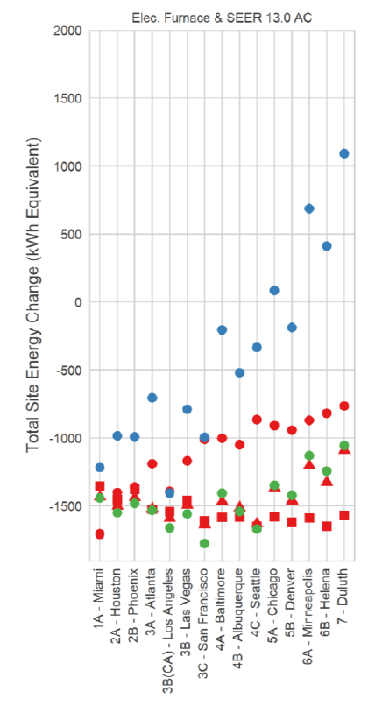
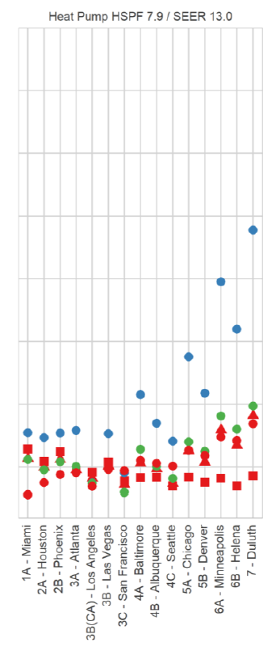
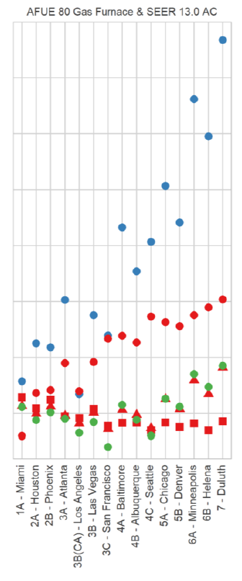
Exhaust-Only Ducting Energy Savings Comparison
The graph shows the energy penalty of exhaust only ducting in cold climates. The cities in the study range from the warmest in Miami, Florida, to the coldest in Duluth, Minnesota. The vertical axis indicates the overall impact on a home's energy use, including the heating and cooling system using various tank locations and ducting strategies. Any marks above the 0 on the vertical axis indicate an overall increase in household energy use.
Interior Exhaust-only
Interior – No Ducting
Interior Dual Ducting
Basement Exhaust-only
Basement – No Ducting
Basement Dual Ducting
Garage Exhaust-only
Garage – No Ducting
Garage Dual Ducting
*Research conducted by Sarah Widder, Cadeo Group LLC, Ben Larson, and Ecotope, Inc in “The HPWH Handbook: Optimum Installation Practices and Answers to Lingering Research Questions”
Notes:
P1090

Slide 23
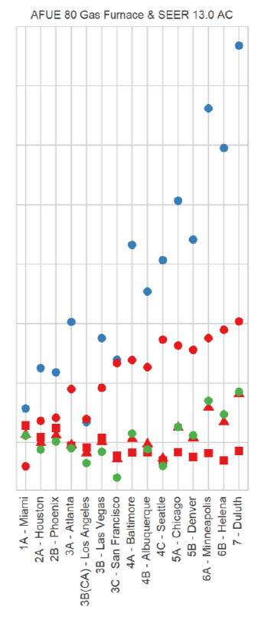

Exhaust-Only Ducting Energy Savings Comparison (cont.)
This portion of the model focuses on homes with a mid-efficiency gas furnace and a mid-efficiency air conditioner. The assorted colors and shapes of the marks indicate various tank locations and ducting methods, if utilized to overcome volumetric constraints.
Focusing on the blue dots, the results indicate in all locations there is an energy penalty when exhaust only method is utilized; and in colder climates the effect is large enough to increase total energy use within the household. During exhaust only ducting, a Heat Pump Water Heater draws conditioned or semi conditioned air from inside the house and exhausts it outside. This significantly drives up the infiltration load of the house, causing the home's heating and cooling system to operate longer to work to condition the air leaking into the house that is replacing the air being exhausted. In winter climates such as in Portland, Oregon or Seattle, Washington, exhaust only ducting would significantly reduce energy savings by over 1,000 kWh/year, with even greater reduction in climates like Duluth, Minnesota.
Interior Exhaust-only
Interior – No Ducting
Interior Dual Ducting
Basement Exhaust-only
Basement – No Ducting
Basement Dual Ducting
Garage Exhaust-only
Garage – No Ducting
Garage Dual Ducting
Notes:
P1091

Slide 24
Differences Between Standard Electrics and EHWHs
Prepare your customers for the changes they will experience when switching from a standard electric to an electric hybrid water heater.
Item | Standard Electric | Electric Hybrid Water Heater
Noise Level | None | While operating, similar decibel level to a modern dishwasher
Maintenance | Check for leaks Replace anode as required | Check for leaks Replace anode as required Clean filter as required
Wi-Fi Connectivity | None | App available on certain models
Lowering or Raising Water Temperature | Involves turning power off to unit, unscrewing access panels | Done with the touch of a button
Size | Standard | Taller than a standard unit
Notes:
P1102
Point of Slide: Highlight differences between ERWH and EHWH – prepare customers for these differences when replacing a water heater

Slide 25



EHWH Benefits
On average, $80-100/person in annual savings per household
Immediate savings through rebates
90% consumer satisfaction [1]
Peace of mind: 10-year warranty with modest maintenance
Same reliable hot water delivery
[1] Monica Nevius, Jared Powell, Melissa Meek, “Northwest Heat Pump Water Heater Market Progress Evaluation Report #6”
Notes:
P1038
Point of slide: Outline the benefits of EHWHs and why a contractor would want to sell a EHWH and/or why a consumer would want to own one

Slide 26

EHWH Benefits vs. Standard Tanks
features
Benefits
EHWH
Standard tank
Reliable
Hot Water
Hot water when
you need it
10 Year Warranty
Peace of mind
Cuts cost
by up to 70%
Save up to
$100/person
annually or $2,000+ over 10 years
Rebates to offset cost
Low upgrade costs lead to faster payback
If qualified, customer gets additional credits/rebates to offset cost
Inflation Reduction Act Credit
Leak Detection
Notes:
P1045
Point of Slide: Summarize the comparison of benefits between products

Slide 27
Thank You
For more information, visit Hot Water Solutions or reach out to us with questions at info@hotwatersolutionsnw.org or by phone at (888) 444-8962.
Notes:
P1114
Point of slide: End of Training – Call to Action

